Slide 1

Shop-here
Lakshmi Narain College of Technology
DEPARTMENT OF INFORMATION TECHNOLOGY- 3rd year
An E-Commerce website using Django
Submited by :- SHUBHAM GUPTA – 104
SOURAV YADAV – 101

Slide 2
Problem statement:-
This Existing system of buying goods has several disadvantages .It requires lots of time to travel to the particular shop to buy the goods. Since everyone is leading busy life now a days, means a lot to everyone. Also there are expenses for travelling from house to shop. More over the shop from where we would like to buy something may not be open 24*7*365. Hence we have to adjust our time with the shopkeeper’s time or vendor’s time.
It is really hard to get same time to go out and get them by ourselves due to busy life style or lots of works. In order to solve this E-Commerce websites have started.

Slide 3
Introduction :-
Shop Here is a form of electronic commerce which allow consumers to directly buy goods or services from a seller over the internet using a web browser. where user can buy product online with online payment facility
User can also Track his/her order
Here a blog facility is also available where admin can create and post blog about fashion, new products ,and users can like ,comment and share the blog on their facebook id directly
Also if user is facing any problem ,can contact us on website ,where we can resolve problem as soon as possible.

Slide 4







Technology used :-
FrontEnd
HTML,CSS,JavaScript
jQuery,Bootstrap
Middleware
Python
Django
Backend
Sqlite database
IDE
Pycharm
Django server
Others
Facebook Plugins
Google Signin API
Paytm Gateway

Slide 5
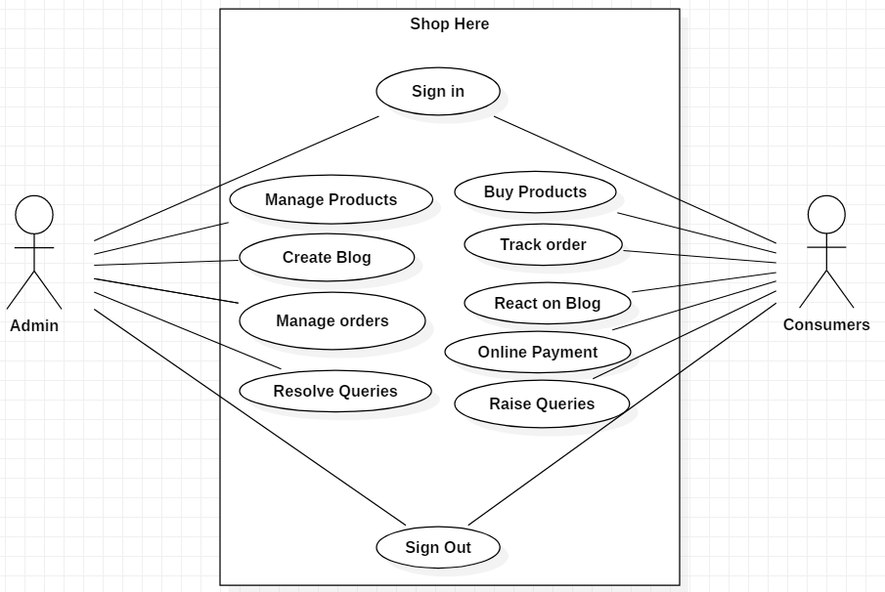
USE CASE DIGRAM:-

Slide 6
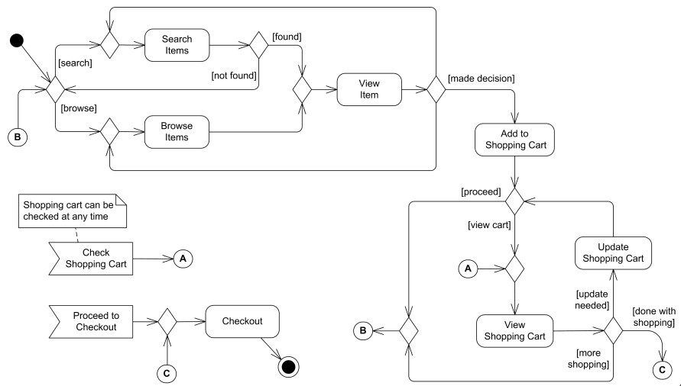
User side dataflow diagram:-

Slide 7
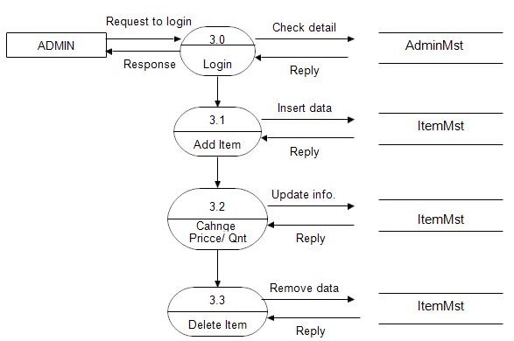
Admin side dataflow diagram:-

Slide 8
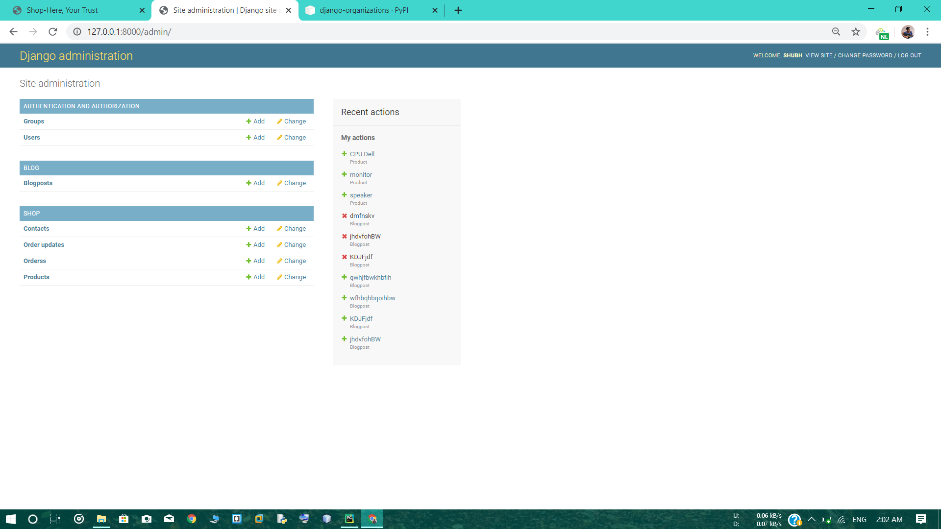
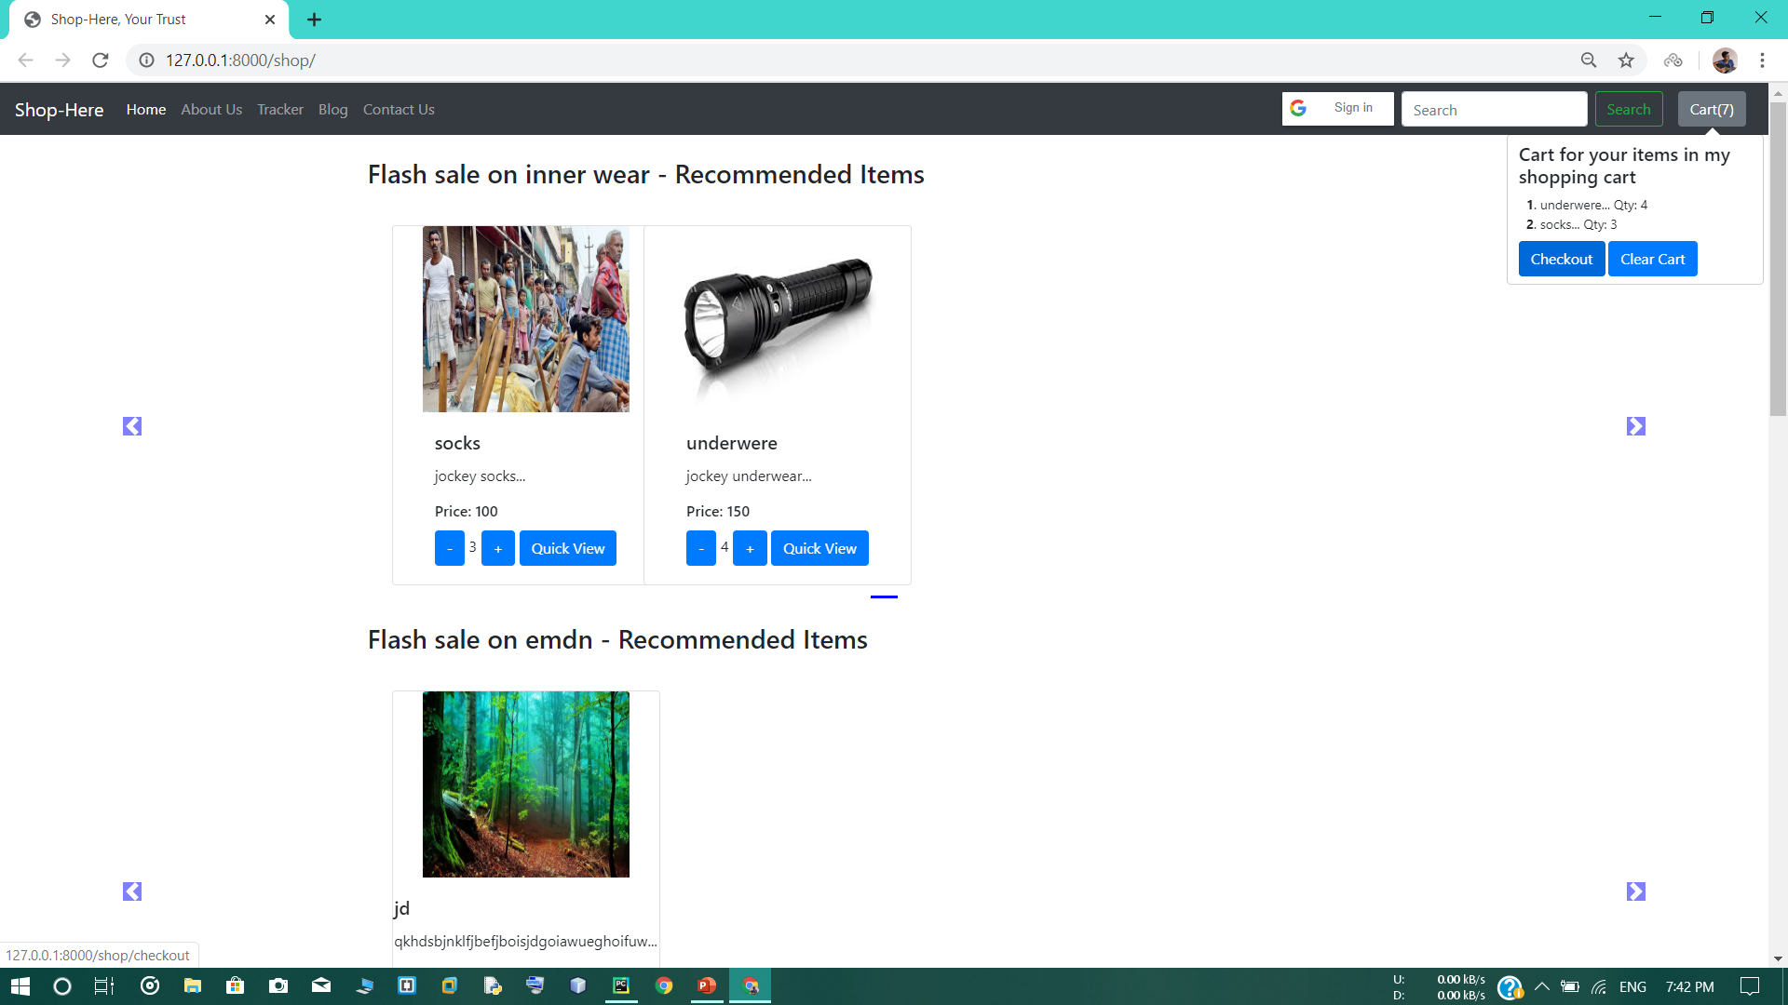
Admin page:-
Home Page :-

Slide 9
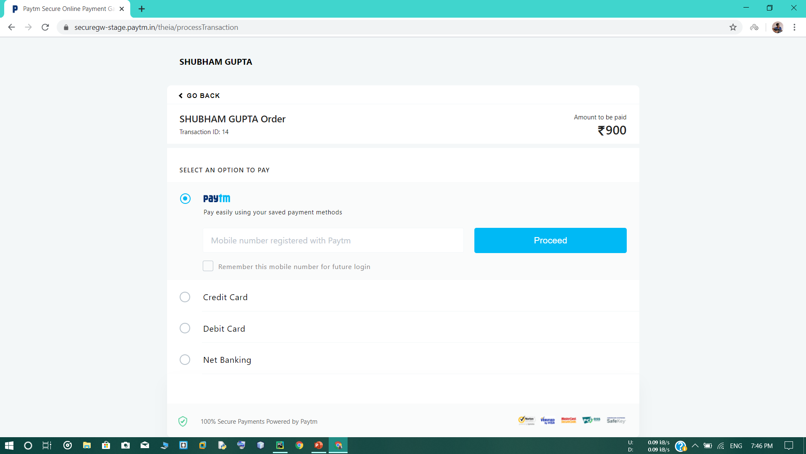
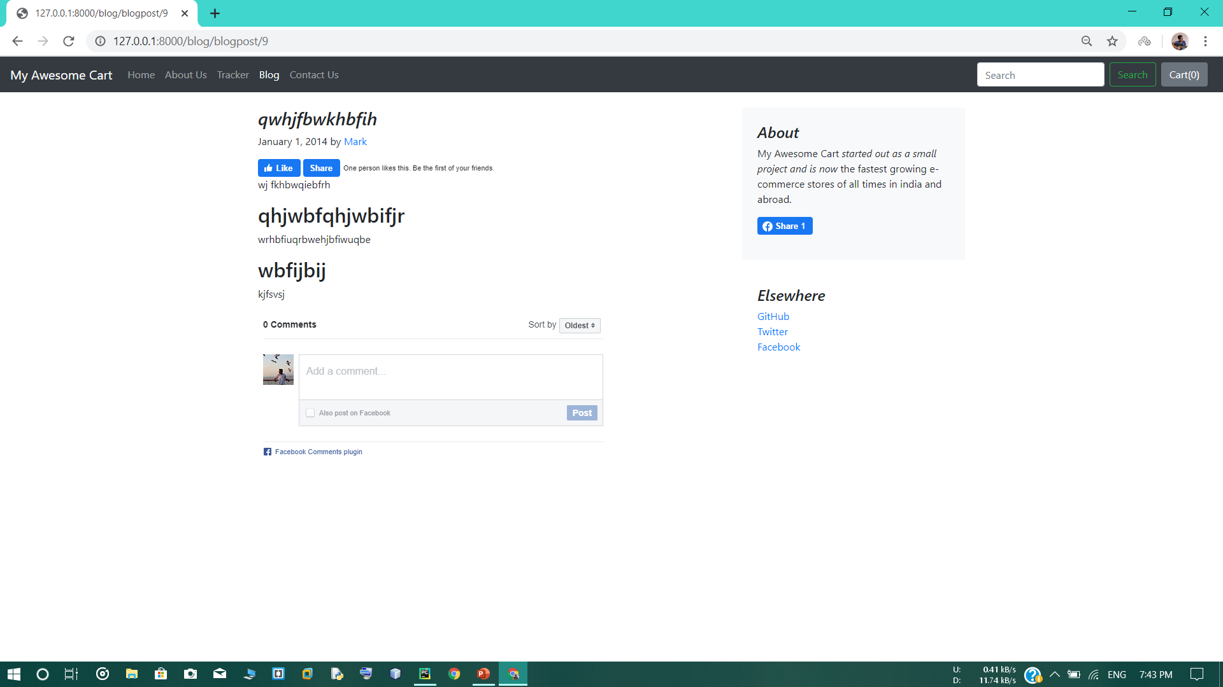
Paytm Gateway :-
Facebook Plugins:-

Slide 10
CONCLUSION:-
Consumer buys goods from the online shopping.
It provides a friendly graphical user interface which can easily operated by customers.
Our system is provide simplicity to shopkeeper for managing inventory information.
Being able to buy any time, any place and any where according to your choice.
The project could very well enhanced future as per the requirements.

Slide 11
Thank you

